Slide 1
Course Introduction
Lecturer: Ngo Huy Bien
Department of Software Engineering
Faculty of Information Technology
University of Natural Sciences, VNU HCMC
nhbien@fit.hcmus.edu.vn

Slide 2

Lecturer
Ngô Huy Biên, PhD
Department of Software Engineering
Faculty of Information Technology
University of Natural Sciences, VNU HCMC
Email: nhbien@fit.hcmus.edu.vn
Office location: I82.
Office hours: Wednesday & Friday: 13:30 p.m. – 17:10 p.m.

Slide 3

Objectives
To decide whether to register for the course.
To estimate an expected grade for yourself.

Slide 4

Contents
Course target learners.
Course learning outcomes.
Course contents.
Course schedule.
Course assessment.
Teaching and learning methods.
References.
Course policies.

Slide 5



I am a Student
Should I attend this course?

Slide 6

I am a Student
How to build a cloud system to solve a real world problem?

Slide 7

I am a Student
What are the foundations of research in cloud computing?

Slide 8

I am a Developer
Should I learn this course?
Data engineer: Designing, building, and deploying systems for collecting, storing, and analyzing data at scale.
Solution architect: Distributed systems and cloud computing.
Solution architect salaries can range from $3000 to $5000 USD per month.

Slide 9

This Course is Not for
people who do not like programming.

Slide 10

But
It does not matter whether you want to know about cloud computing, as long as you still involve in software development it still seriously affects your career.

Slide 11



Course Prerequisites
Prerequisites:
Operating Systems
Computer Networks
Database Management Systems
Machine Learning
Prior-courses:
Distributed Systems
Software Architecture
Web Application Development
Parallel courses:
Blockchain Technology
Required knowledge and skills:
The ability to read English books and research papers
The ability to write reports
The presentation skill

Slide 12

Course Learning Outcomes
Deploy software to cloud.
Develop software using cloud services.
Develop data intensive software in the cloud.
Identify a potential cloud research topic.

Slide 13


Course Contents
Cloud Computing Concepts
Infrastructure as a Service: Amazon Web Services.
Platform as a Service: Salesforce Platform.
Private Cloud: VMWare, TrueNAS.
Cloud-Native Architecture: Terraform, AWS CloudFormation, AWS Serverless Computing.
Storage in the Cloud: GFS, Bigtable.
Programming in the Cloud: Hadoop, Spark.
Details: Refer to the course syllabus.

Slide 14

Course Schedule
The number of credits: 4
Theoretical lessons: 45
Practical lessons: 30
Self- learning lessons: 90
Detailed schedule: Refer to the course syllabus.

Slide 15

Class Monitors

Slide 16


Course Assessment
The final grade is combined of:
6 individual labs (60%)
Final oral exam (40%)
Bonus points (up to 20%) for:
Students who actively answer questions in classroom correctly
Personnel board (1 class leader and 1 deputy class leader)
Detailed assessment: Refer to the course syllabus.

Slide 17

Individual Labs (60%)
Amazon Web Services: 10%
VMware: 10%
Salesforce Platform: 10%
TrueNAS: 10%
Terraform, AWS CloudFormation, AWS Serverless Computing: 10%
Hadoop, Spark, Amazon EMR: 10%

Slide 18
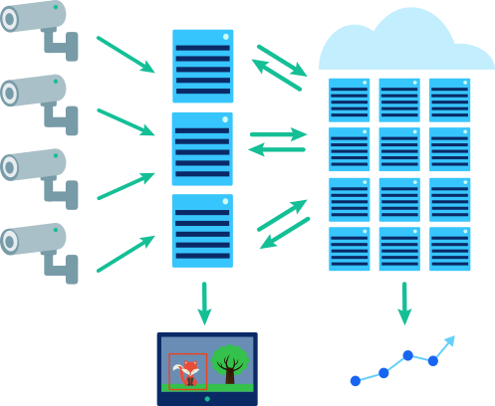
Programming Demonstration (10% each)
Programming in the Cloud: Hadoop, Spark.

Slide 19
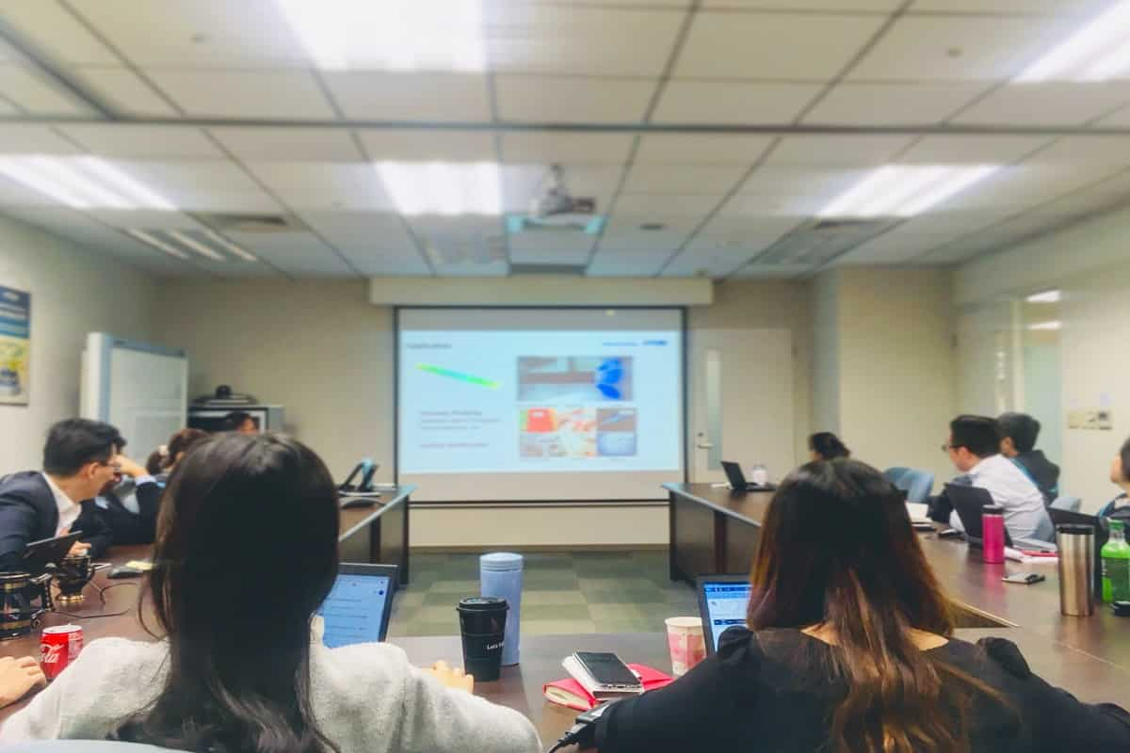
Paper Presentation (10% each)
Research papers.

Slide 20



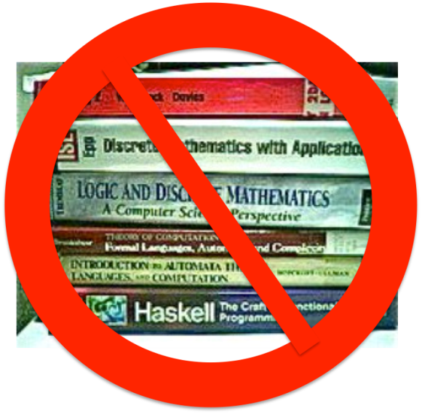
Final Individual Oral Exam (40%)
Papers, programs, source code, documents, videos and related resources.

Slide 21

Course Policies
Students who are absent for more than 30% of the course time shall not be allowed to take the exams and be graded 0 for the whole course.
Students who are graded 0 for the course project or for the total score of the individual tests shall not be allowed to take the exams.
Students who are absent during a test session will be graded 0 for the test. The exception can only be applied to students who have a hospital certificate of medical status.
Students who does a classroom test or homework or project for their friends will be graded 0 for the course.
Students who do plagiarism for their exercises or projects will be graded 0 for the course. This also applies to cases in which the lecturers find out later when students will have already completed the course.
Students who have proof of their friends’ cheating or plagiarism but do not notify the lecturers will be deducted 50% of the total grade that they will have achieved.

Slide 22

References
Dan C. Marinescu (2022). Cloud Computing - Theory and Practice. Morgan Kaufmann.
Andreas Wittig and Michael Wittig (2022). Amazon Web Services in Action. Manning Publications.
Nick Marshall et al. (2018). Mastering VMware vSphere 6.7. John Wiley & Sons.
Philip Weinmeister (2019). Practical Salesforce Development Without Code. Apress.
Rathinaraja Jeyaraj et al. (2021). Big Data with Hadoop MapReduce - A Classroom Approach. Apple Academic Press.
Tomasz Wiktorski (2019). Data-intensive Systems - Principles and Fundamentals using Hadoop and Spark. Springer.
Specific materials for each course topic: Refer to the course slides.

Slide 23

Questions and Answers

Slide 24

Thank You & See You Again

